Slide 1
Macro-economic Analysis
of
Indian IT Sector
Mid-term Seminar
By: Abhinav Singh – Wipro
Anushka Panda – L&T Infotech
Arun Soni – Tech Mahindra
Ayushi Jain – Mindtree
Chirag Goswami – NIIT Tech
Harshit Kumar Dubey – Infosys
Mihir Shah – Hexaware
Sankalp Khandelwal – HCL Technologies
Sarthak Dalmia – Cyient
Shashwat Singh – TCS
As a part of PS-I project requirements of BITS Pilani, at William O’Neil, India

Slide 2
Overview
This presentation will consist of a brief introduction of the Macroeconomic Overview of the IT sector. A few significant details are mentioned, though the complete details were put up in the Mid-term report.
India’s IT industry contributed around 7.7 per cent to country’s GDP (Gross Domestic Product) and is expected to contribute 10 per cent to India’s GDP by 2025. Total number of employees grew to 1.02 million cumulatively for four Indian IT majors (including TCS, Infosys, Wipro, HCL Tech) as on December 31, 2019. Indian IT industry employed 205,000 new hires and had 884,000 digitally skilled talent in 2019.
IT companies in general, have performed very well in the past few years. IT companies are not very capital intensive; thus, their debts are usually quite low. Most IT companies provide services to sectors like the banking and financial sector, the travel and hospitality sector, the insurance sector etc. and many operate on a global level which gives them a good diversified market.
The major topic of our discussion: the Covid-19 world crisis. Economies have taken a bad hit amidst this world pandemic, and sectors like the travel sector are struggling to survive. Yet, many companies have signed large deals even in the last quarter, which proves that the demand for IT hasn’t reduced as much. Their clients are more in need of automation and digitization than ever before.

Slide 3
Third quarter for this sector has been affected by weak global macro outlook regarding growth in 2020/FY2021 and less working days. Moreover, companies have not benefited much from the corporate tax cut of Sep 2019 as they were already in low tax brackets.
The reduction in growth was mainly due to reduced spending on IT services by Banking & Financial Services industry. Other sectors like Retail, Communication, Healthcare have contributed to the growth.
This quarter is considered as a weak quarter in IT due to less working days. As a result, only Tech Mahindra was able to sign new deals. It can be seen from its positive revenue growth.
L&T Infotech’s growth is supported by large deals in Insurance & Manufacturing sector and recovery from large accounts.
TCS is largely led by operational efficiencies and INR depreciation.
HCL Technology has grown in both IBM products (acquired in July 2019) as well as services segment.

Slide 4
IT Sector Verticals
Banking and Financial Services: The COVID-19 pandemic could be one of the most serious challenges faced by the financial services industry in nearly a century. The COVID-19 impact on banking will be severe – fall in demand, lower incomes, production shutdowns - and will adversely affect the business of banks. The situation is exacerbated by staff shortages, inadequate digital maturity, and pressure on the existing infrastructure as firms scramble to deal with the impact of COVID-19 on financial services.
Retail: According to several reports, as many as 13 retailers in the US with 3,800-plus stores have already filed for bankruptcy in 2020 ytd (year-to-date). These include J Crew, True Religion, J C Penny and Stage Stores. Certain others such as Victoria’s Secret and Bath & Body Works are also potential candidates. Analysts now believe that the retail sector will be the worst hit for Infosys, Wipro and Mindtree and a few others, as their exposure to retail clients is among the highest.

Slide 5
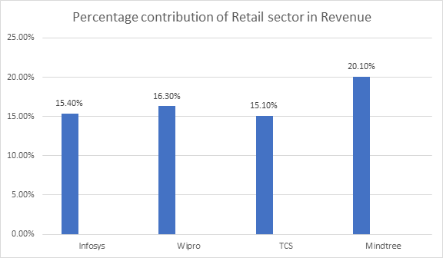
3 . Manufacturing: The global spread of COVID-19 has created an unprecedented situation for the manufacturing sector, resulting from mandated lockdowns across the global ecosystem, not just local or regional ones as in previous disasters. Supply chains are disrupted, stopping the flow of materials, intermediate parts and finished goods. Assembly lines are forced to halt or curtail operations because of a lack of workforce and parts. Innovative adjacencies and health imperatives (like ventilator shortages) have driven product mix changes with alternative components.

Slide 6
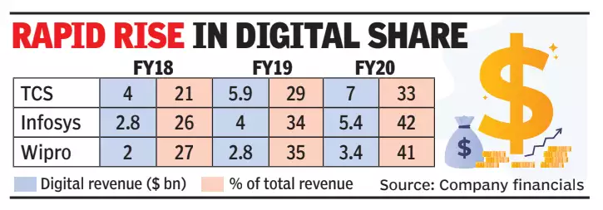
4.Digital Segment: Firms define digital differently. Virtualization, cloud, workspace transformation all form part of digital. That is one of the elements of digital where we will see some traction, anything that helps clients to move more and more of their work into the remote working approach. Services which relate to areas around cloud and virtualization are actually gaining traction. Services which relate to some more project level work, which is discretionary, which will probably be slower
Post COVID-19 we expect a strong opportunity for Cloud, Data Services and creating new digital bank capabilities

Slide 7
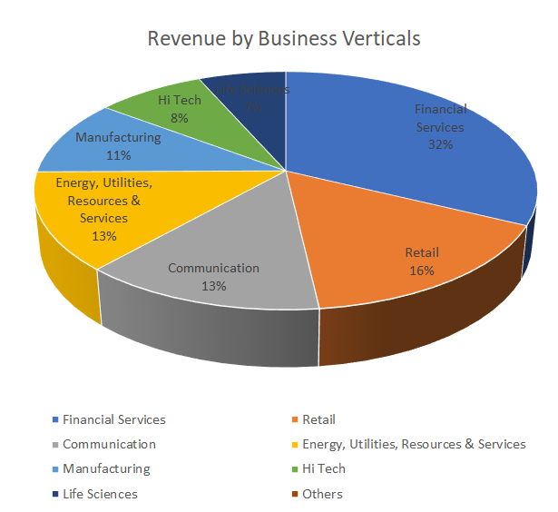
Infosys
In Q4, Infosys grew by 6.4% in constant currency and delivered 21.1% operating margin.
In FY20, Infosys grew by 9.8% in constant currency and delivered 21.3% operating margin.
Earnings per share grew at 8.3%.
Digital revenue grew by 38% and is now 42% of total revenue.
Infosys signed deals worth $9bn in FY20 and worth $1.65 bn in Q4
Infosys won 12 large deals in Q4, out of which four deals were in Retail and Energy Utilities, Resources and Services and one deal each in Financial Services, Communication, Manufacturing and Hi-tech.
Region wise, 7 were from America and 5 were from Europe.
At the end of Q4, cash & cash equivalents were $ 3.61 bn and balance sheet remained debt free.
Five of the business segments Communication, Energy, Utility, Resources and Services, Manufacturing, High-Tech and Life Sciences recorded double-digit growth in FY20.

Slide 8
Verticals Analysis
Financial Service Segment: Financial Services segment is seeing the impact from interest rate decline across the world, which have severely compressed the net interest margin. The banking sector is also expected to experience an increase in loan losses in the near future. Insurance may also see an increase in pressure due to higher claims.
Retail Segment: Retail segment has been hit hard especially non-grocery, apparel, lifestyle and fashion, logistics, etc. While on a sequential basis there has been positive performance in the last quarter and there was a healthy level of large deal wins from this segment, a significant pressure on spend for the segment in the coming quarters is expected.
Energy, Utility, Resources, and Services: With low energy prices and demand and supply chain issues in other sub-segments, the performance is expected to be weak in the near term.However, with low energy prices and demand and supply chain issues in other sub-segments, the performance is expected to be weak in the near term.
Manufacturing Segment: COVID-19 spread exacerbated by supply chain disruptions has resulted in a widespread closure of production facilities across the globe. Stoppage and probably reduced travel in the near future will also affect the aerospace industry in terms of order book and deliveries.

Slide 9
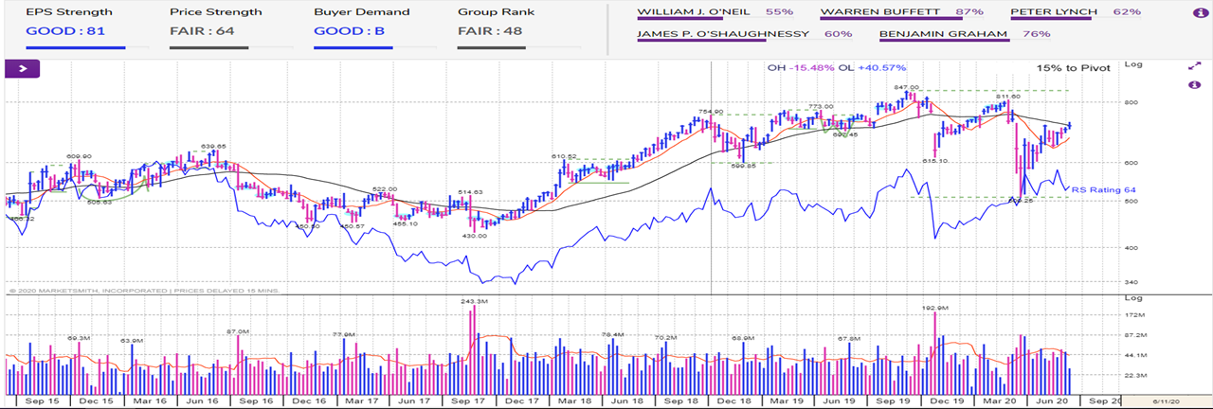

Slide 10

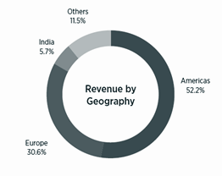
Tata Consultancy Services (TCS)
Revenue grew at 7.1% in constant currency in FY20, EBIT margin (operating margin) was at 24.6% while the net margin was at 20.6%. Dividend of the year at 73 rupees.
Deceleration ( FY19 revenue growth 19.0%) is on account of the lesser currency benefit received in FY 2020 (7.6% currency benefit in FY 2019 vs 0.1% benefit in FY 2020) and volatility in demand in the financial services and retail verticals.
Net cash flow from operations was 88.09 billion rupees which is 109.4% of the net income. Free cash flow was 80.68 billion rupee, for the full year it was `323.03 billion, which was 9.4% YoY growth.
Q4 revenue grew at 3% in constant currency YoY, operating margin at 25.1% YoY and net margins at 20.2% YoY.
Impact in Q4 was due to two-third from supply side and one-third from demand-side challenges and in Q1 is expected from demand side.
Pandemic completely reversed the positive momentum of first two quarters of FY20. The economic impact of the pandemic ripple is felt across all TCS’ industry verticals and major markets.
Geography wise, Europe continue to outperform, growing 11.9% while UK grew 5.4%. North America was flattish at 0.2%. Among the emerging markets, Latin America and APAC grew 3.9% and 3.5% respectively, while MEA grew 1.3% and India declined by 1.9%. in the last quarter of FY20. Additionally North America bagged deals worth $5.3 Billion.

Slide 11
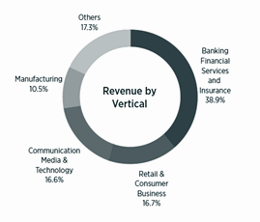
TCS had deals worth $8.9B ( $2.4B - BFSI + $3.1B - Retail ) Walgreen Boots Deal - worth $1.7B
1.Banking, Financial Service and Insurance (Revenue: 61,095 crore): BFSI revenue declined in Q4 by 1.3%. Much of the revenue leakage was due to the supply side impact arising out of delays in or inability to activate remote access regulatory concerns. Banking operations, their security processes, their regulatory and compliance processes are quite complex and involved, and getting a sign off on the new operating model has been time-consuming. Large banking operations business has been the most impacted.
2. Retail Sector and Consumer Business (Revenue: 26,280 crore): Retail grew 4.2% despite a sharp hit in the Travel, Transportation and Hospitality sub-vertical
3. Communication, Media and Technology (Revenue:25,978 crore): Communications and Media business continues to do well, growing 9.3%, while Technology and Services grew 3.5%. Media had a significant downgrade impact due to Covid-19 pandemic like cancelation of Olympics, other events, etc.
4. Manufacturing (Revenue:16,468 crore): Manufacturing grew 7% in Q4
5. Others {Life sciences and Healthcare}(Revenue: 27,128 crore): Life Sciences and Healthcare continue to grow strongly clocking 16.2% in Q4.
Demand is expected to increase for services around digital channels, collaboration and workplace transformation, online learning and workforce analytics. Companies are also expected to invest more towards building operational resilience, leveraging analytics, intelligent automation, cloud and cyber security. TCS’ Location Independent Agile (SBWS) and Machine First Delivery Model. Increased M&A activity in certain sectors are expected. Job security over salary cuts. Hiring freeze for Q1 FY21.

Slide 12
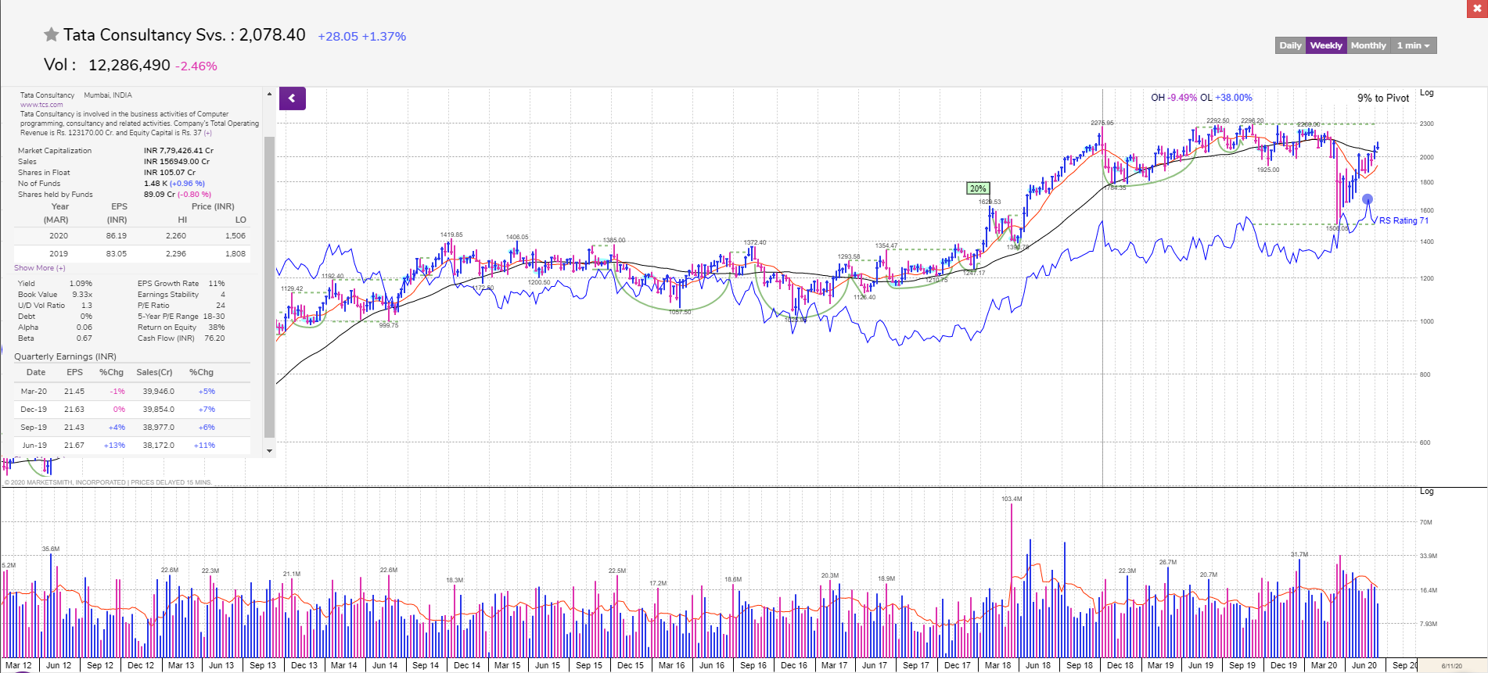
TCS’s RS rating is 71, mediocre performer in the market.
MarketSmith India Graph

Slide 13

Wipro
Financial Summary for the quarter ended March 31, 2020
• Wipro Ltd.’s quarterly profit declined as the Covid-19 pandemic stalled economic activities worldwide and disrupted trade.
• Net profit fell 4.5 percent sequentially to Rs 2,345 crore in the quarter ended March.
• Revenue rose 1.56% percent over the previous quarter to Rs 15,711 crore—in line with the estimated Rs 15,640 crore.
• Revenue from IT Services declined 1.1 percent to $2,073 million.
• Operating profit fell 4.2 percent to Rs 2,539 crore.
• Margin narrowed 100 basis points to 16.1 percent.
• Wipro did not give a revenue growth forecast for the ongoing quarter, citing disruptions from the pandemic.
• Wipro added 65 new customers during the quarter. Only one new customer was added in the $100 million-plus bracket. The company had over 1.82 lakh employees as of March-end, lower than 1.87 lakh employees in the preceding quarter.
• Digital is growing strong with its revenue share reaching 41.2% at the end of Q4’20 from 34.8% in Q4’19.
• Wipro 3D ties up with SCTIMST to make automated ventilators for the COVID’19 patients.
All figures based on IFRS | Q4’20 | YoY Growth | QoQ Growth
Revenue | 157,110 | 4.70% | 1.56%
Operating Income | 25,367 | -5.95% | -4.10%
Net Income, GAAP | 23,260 | -6.33% | -5.28%
EBITDA Margin (%) | 19.85 | -6.50% | -3.41%
Market Capitalization | 1,123,817 | -26.90% | -19.97%
EPS | 4.09 | -1.21% | -5.10%

Slide 14
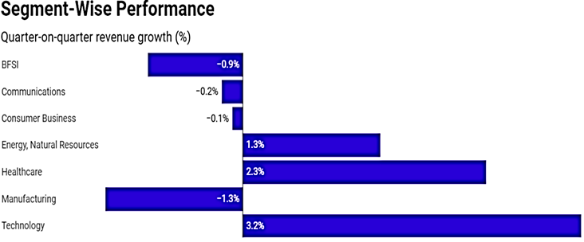
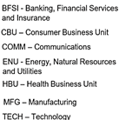
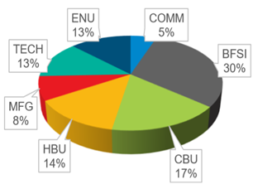
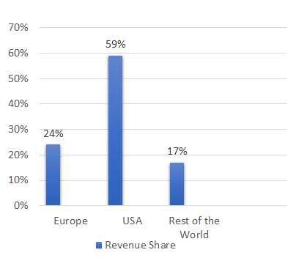
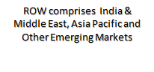
Revenue Breakup - Q4’20
Business Unit Distribution
Geographical Distribution
Geographically, the Americas region saw a 1.2 percent decline revenue. Europe grew 0.7 percent while the rest of the world declined 2.8 percent.

Slide 15
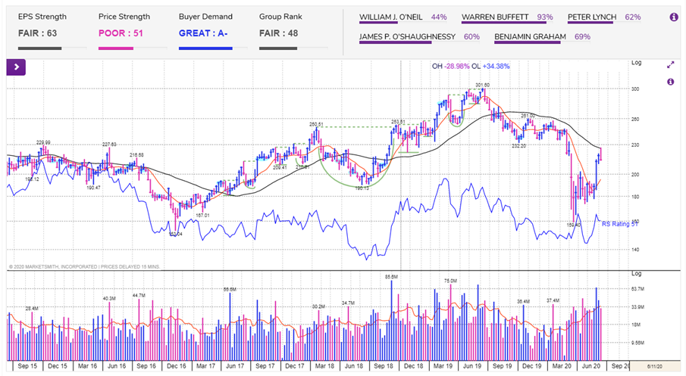
Market Smith India Graph for Wipro Ltd.

Slide 16

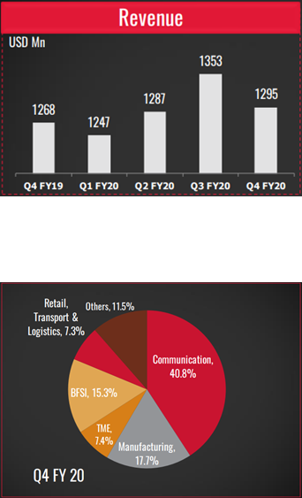
Tech Mahindra
Financial Highlights of Q4FY20
Revenue: 3.3% decline in constant currency,
Almost half of this (~160bps) is due to COVID in two or three areas.
•One is BPS business, there were some supply side constraints as well as some approvals which needed to be taken, so those impacted the revenue.
•On the network side, customers defer the spend because it is one of the items which can be deferred pretty easily for the shorter-term.
•The third is Comviva business that is dependent on renewals as well as new sales
The other streams which contributed to decline was retail which was about 40 to 50 bps and the last 100 to 120 bps is all about the reduction in volume at a net level.
The breakup of revenue sector wise for Q4FY20 is given in the graph

Slide 17
EBIT: It was 10%, with a decline of 220 bps from the previous quarter.
•Included CSR of 100bps
•Covid related and lower utilisation of services was about 80bps
•Currency value fluctuations was approximately 30bps
•Some impact due to transition costs for new deals.
PAT: PAT was impacted by the yearly exercise of one -time impairment, the goodwill in some of our subsidiaries. This time around considering the environment, there were some subsidiary goodwill impairment.
Excluding that, PAT was about 138 million, about 11% overall.
Management thoughts and future projections:
The Covid-19 pandemic has brought an unprecedented change in the business model for the IT industry. While the demand traction seen through the first three-quarters of FY19-20 has reversed in Q4, we expect that the focus on digital transformation, remote working, and network modernisation will recover in the medium term,” said C P Gurnani, chief.
According to the management, it is seeing pockets of delays in discretionary spends. This can weigh on revenues in the near term. The retail and manufacturing areas will take a hit while banking and government will continue strong
“As of date none of us has a definitive answer," C.P. Gurnani, managing director and chief executive of Tech Mahindra, on the margin trajectory. The improvement is contingent on duration of the covid-19 disruption and return of normalcy thereafter.

Slide 18
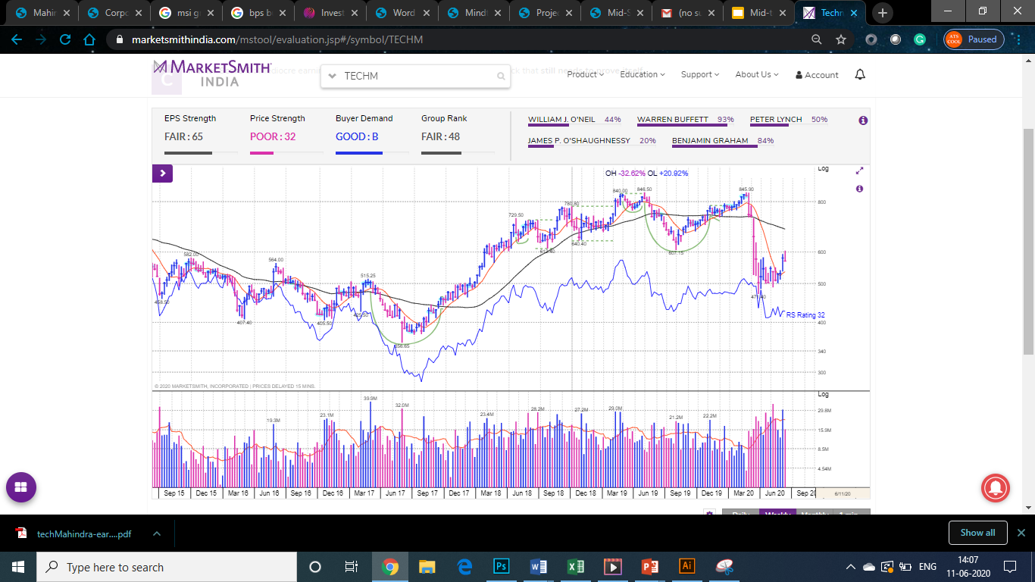

Slide 19
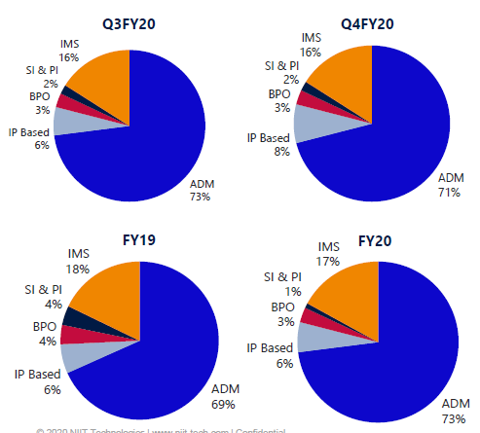
NIIT Tech
IT solutions company: focus on automation, DA, Cloud and Digital computing, and app development and management
Revenue grew 13.8% over last year, EBITDA grew by 11.6% but margins contracted by 35 bps, yet still remained respectable at 17.2%
$180M order intake giving a total business of $468M orders executable over next 12 months, up 20% from last year
Growth in EMEA due to higher revenues from BFS, NITL and Whishworks, and decline in America due to lower revenue in TTH sector on QoQ basis
TTH declined by 2.1% sequentially in Q4, BFS remained flat and insurance grew by 5.8%, owing to the effects of the Covid 19 crisis.
Other segments expanded 8.7% QoQ to make 26.7% of total revenue
NIIT signed 4 large deals in Q3 and 3 large deals in Q4, showing good promise
In FY20, 90% of their clients were not new clients, showing client trust
Debt remained 0, while cash reserves grew almost 3-fold, strengthening their economic moat
Attrition rate fell to 11.75% due to selective hiring

Slide 20
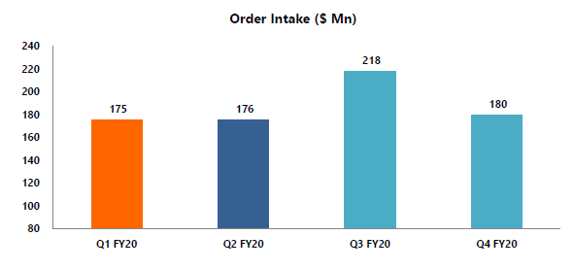
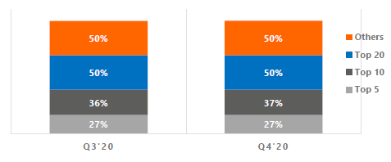
Top Client Mix

Slide 21
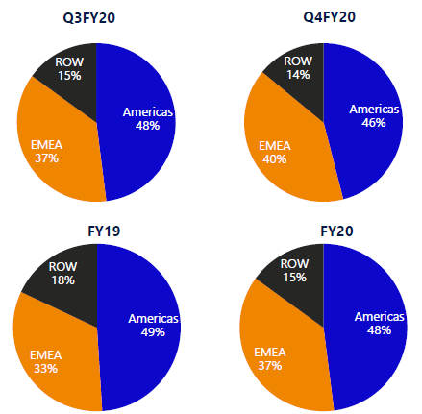
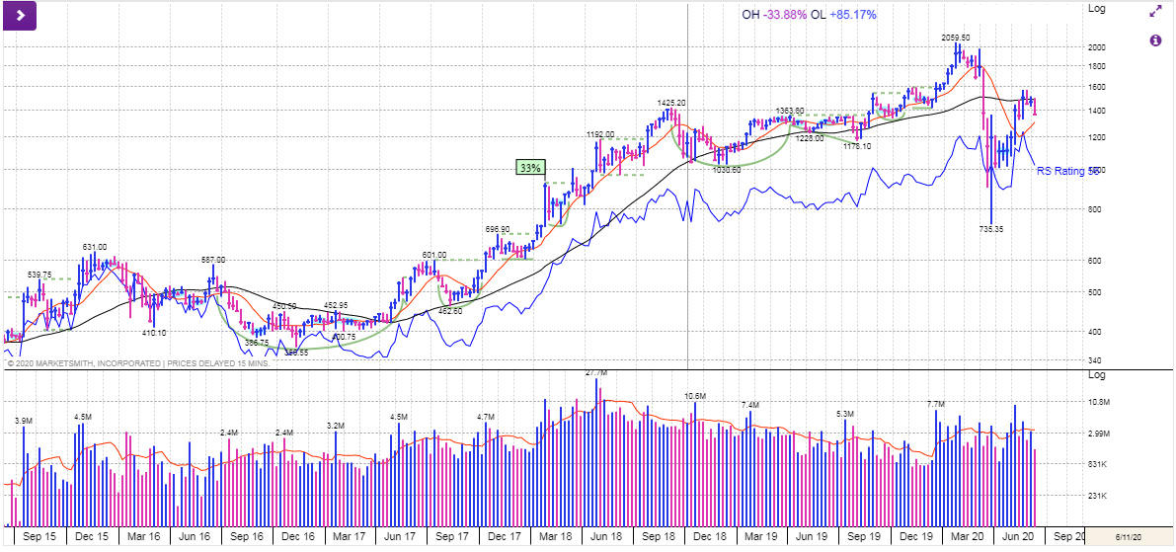

Slide 22
HCL Technologies
Quarter | Revenue | Net Income
Q3 2019 | 1,58,691.273207 | 26,238.302724
Q4 2019 | 1,60,500.549507 | 25,669.659402
Q1 2020 | 1,64,367.925042 | 22,232.368267
Q2 2020 | 1,74,967.076401 | 26,481.579555
Q3 2020 | 1,81,139.129854 | 30,375.025117
Q4 2020 | 1,84,334.956763 | 31,266.061315
HCL Technologies posted better-than-expected financial results for the quarter ended March 2020.
The IT firm reported a 22.80 per cent year-on-year (YoY) and a 3.80 per cent quarter-on-quarter (QoQ) growth in net profit at Rs 3,154 crore.
Revenue of the company increased 16.30 per cent YoY and 2.50 per cent QoQ to Rs 18,590 in Q4FY20.
89 new clients in Q4- HCL’s total clients stood at 1,411 at the end of March quarter. The company added 91 new clients – of which two are in $20 million-plus bracket. However, it lost two clients in the $50 million-plus bracket.
The company also signed 14 transformational deals during the quarter.
Company has refrained from giving a forecast for the upcoming quarters.

Slide 23
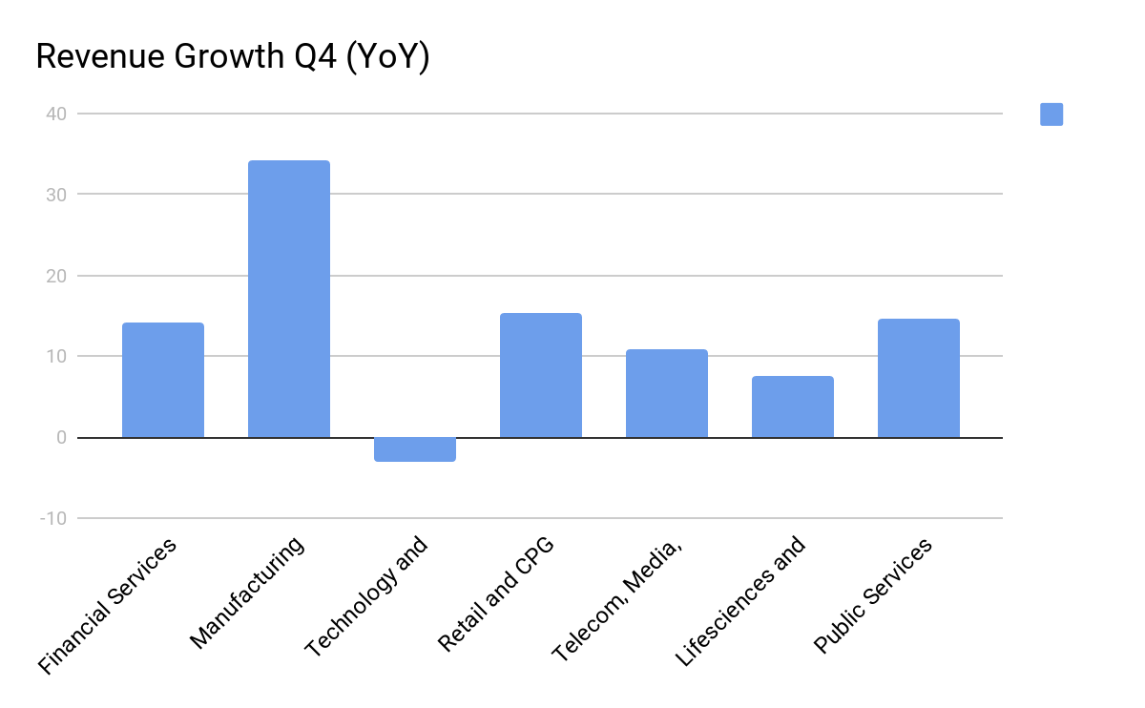
Verticals Analysis
A strong demand in weak verticals and weaker demand in stronger verticals has made the result of current quarter quite uncertain.
Technology and services, one of the stronger verticals of the company, has shown a slight decline of 3 percent.
Public services, a weaker vertical, has shown above average growth in Q4 2020.
Manufacturing is currently stressed due to demand side constraints and may adversely impact the current quarter revenue.
Company has signed 14 major dealings in strong sectors - Telecom, Manufacturing, Tech and Services, Retail and CPG and Financial Services in Q4 2020.
The above signed deals may convert in H2 of the year.

Slide 24
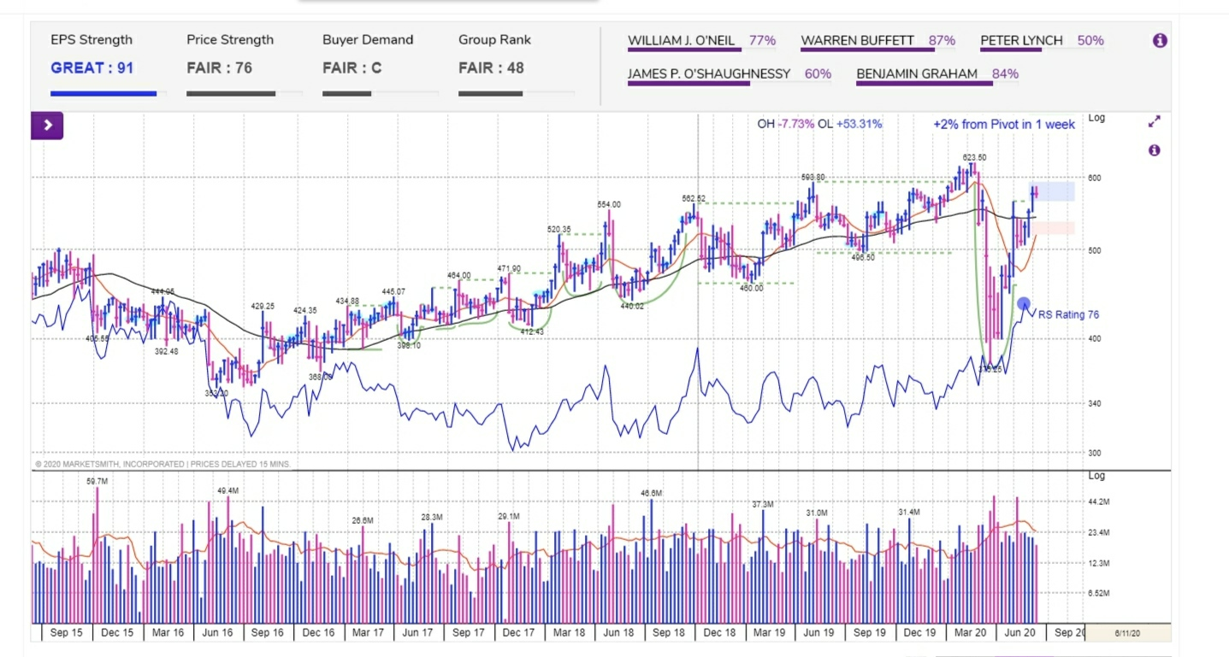

Slide 25
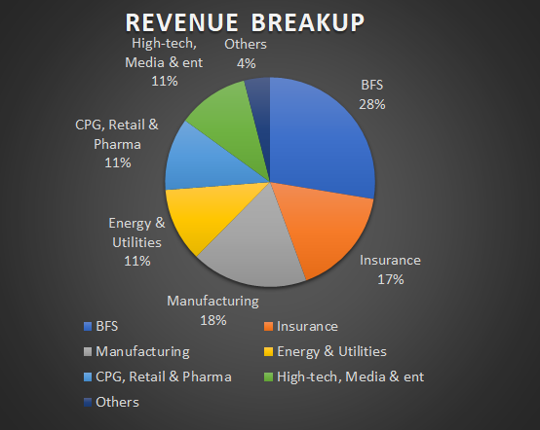
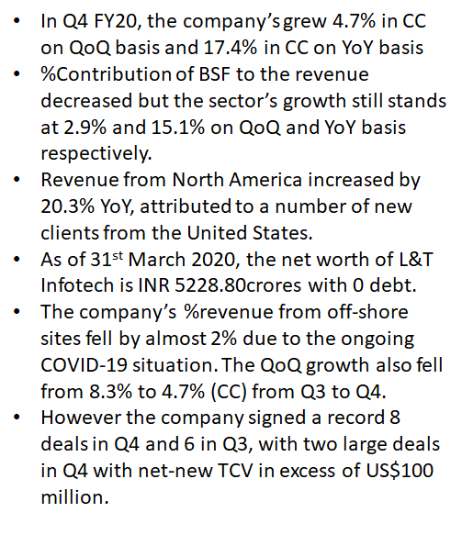
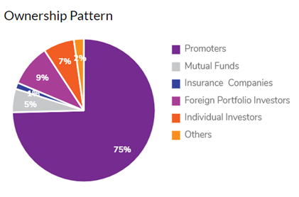
L&T Infotech

Slide 26
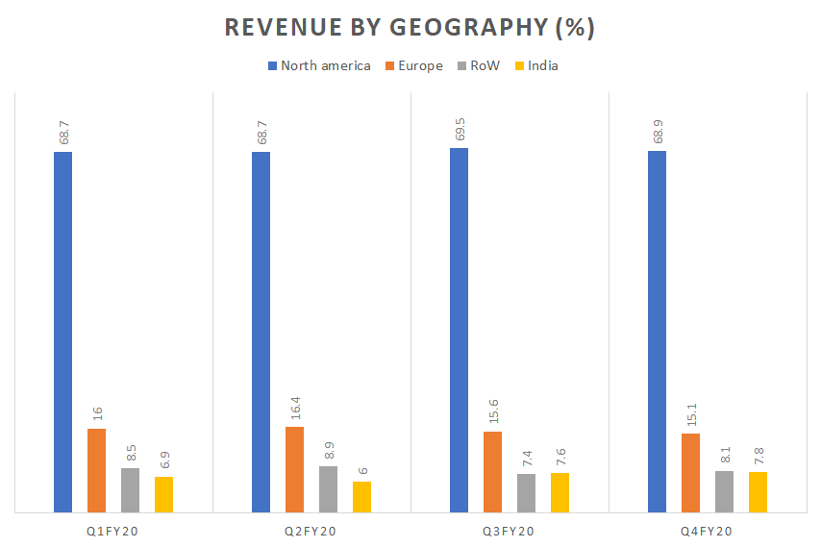
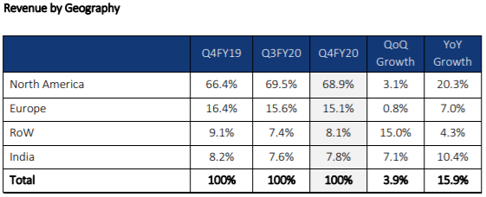

Slide 27
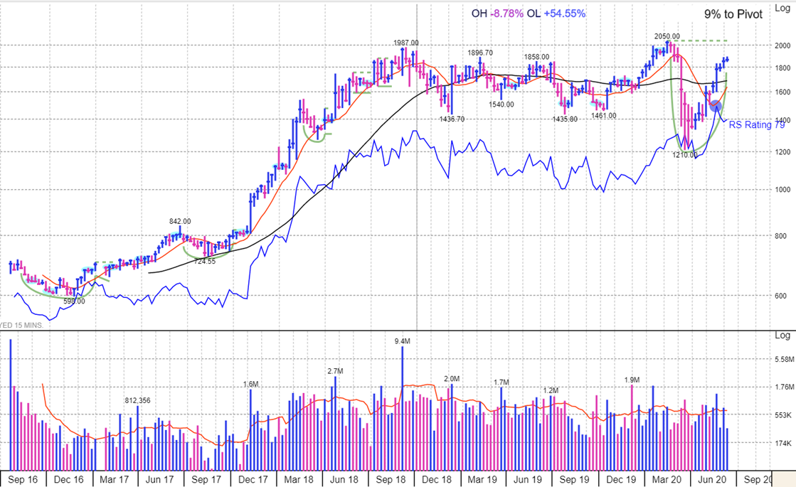
MarketSmith India Graph
The stocks have an RS rating 79, meaning they are mediocre performers in the market.

Slide 28
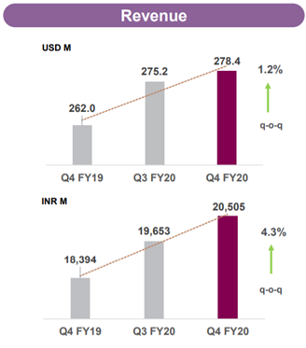
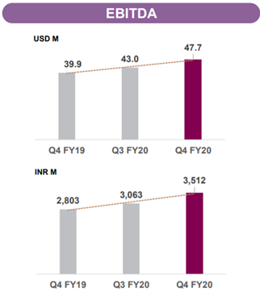
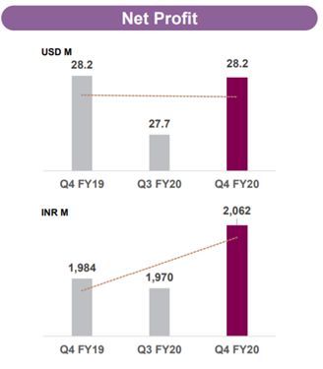
Mindtree
Performance Highlights
For the quarter, their revenue is $278.4 million, with 1.9% growth in constant currency and 1.2% in dollar terms. For the full year, their revenue is $1.1 billion, with a growth of 9.4% in constant currency and 8.7% in dollar terms
Operating profit (EBITDA) stood at Rs351.2cr increasing by 25.3% yoy and 14.7% qoq. EBITDA was at 17.1% in the latest quarter
In Q4FY20, Mindtree logged a net profit of Rs206.2cr growing by 3.9% yoy and 4.7% qoq. Net profit margin was at 21.0% in the latest quarter

Slide 29


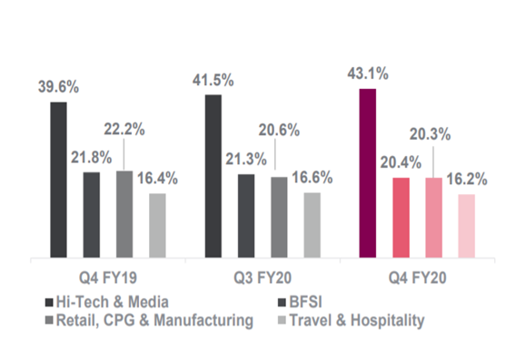
Banking
Capital Markets
Consumer Packaged Goods
Consumer Technology
Education
Enterprise Technology
Insurance
Manufacturing
Media & Entertainment
Retail
Transportation & Logistics
Travel & Hospitality
Hi-Tech & Media: q-o-q growth 5.2%, y-o-y growth 15.5%
BFSI: q-o-q de-growth 3.2%, y-o-y de-growth 0.5%
Travel & Hospitality: q-o-q de-growth 1.3%, y-o-y growth 5.2%
Retail, CPG & Manf: q-o-q de-growth 0.3%, y-o-y de-growth 2.8%

Slide 30
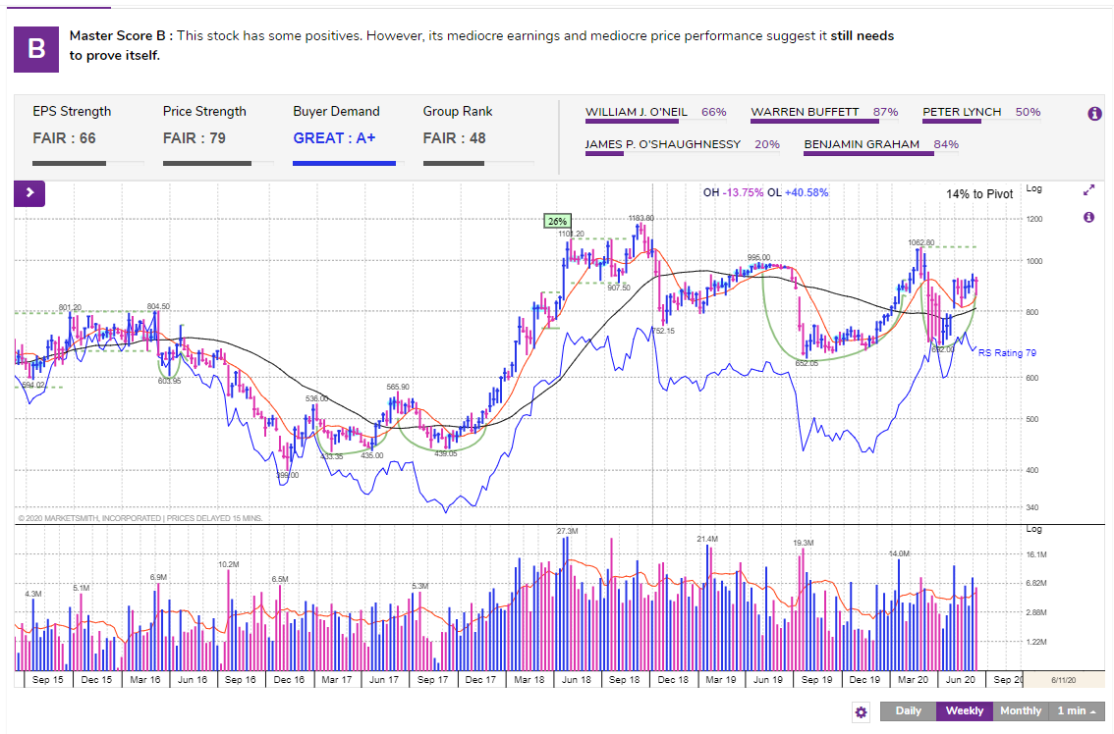
MarketSmith India Graph

Slide 31
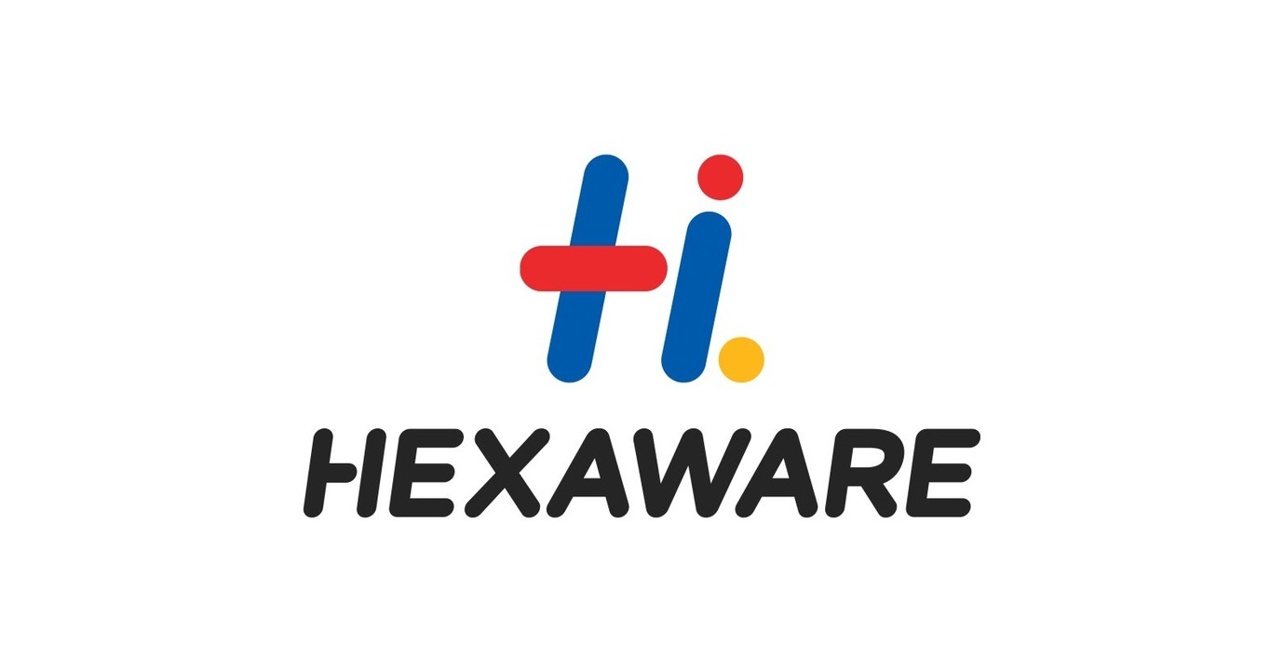
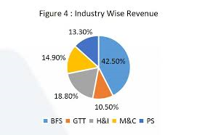
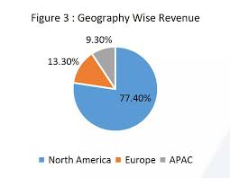
Hexaware
A leading global provider of IT and BPO services.
It provides services to its clients in Banking, Capital markets, Healthcare, Insurance, retail and many more.
It reported 8.6% dip in profit sequentially at Rs. 167.7 crore for the fourth quarter which ended at December 2019.
The company's operating profit increased by 15.2% QoQ during the quarter.
The company reported a total contract value of deal wins worth $30 million compared to $28 million reported last quarter. A lot of new projects are coming in from healthcare, cloud migration and companies moving to platform based businesses.
However, Hexaware’s Dec’19 quarter results were below par with EBIT margin decline of almost 50 bps sequentially impacted by ramp downs at top client and strong hiring in the quarter.

Slide 32
Current Scenario and a word by the CEO
The company had transitioned to a work from home model almost a week before the 21-day national lockdown was announced. 99% of its IT services and 75% (by revenue) of the BPO operations were currently being run from home, with no impact on client delivery.
Speaking at an investor call, R Srikrishna said that in the medium term, they expected a positive impact from this situation as the demand for Cloud based solutions and automation increases.
He also added “This crisis has helped cement customer relationships and built trust and credibility. Once this passes, we will be in a solid position to gain market share.”
On being asked What is the scope for Indian technology companies, his say was that many Indian IT companies would benefit due to a shift in spending to higher value work.
To help the company in cost savings and to allow the management dedicate more time in company’s business, it has decided to delist its shares.

Slide 33
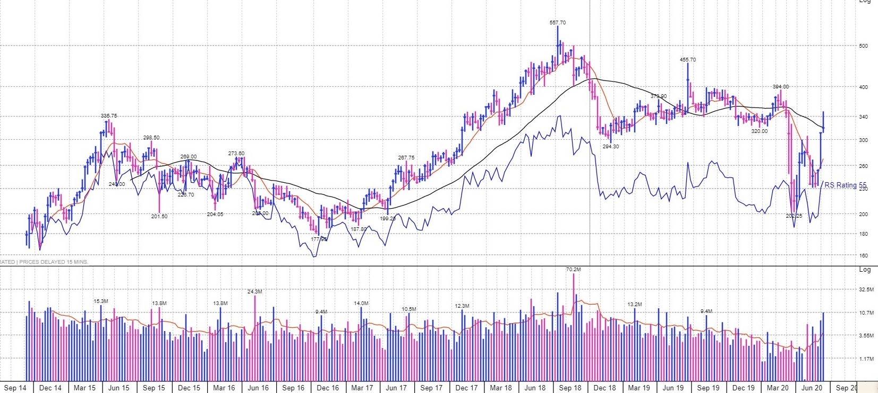
MarketSmith India Graph

Slide 34
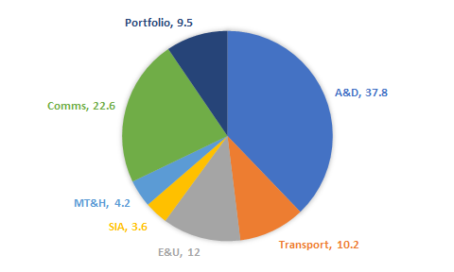
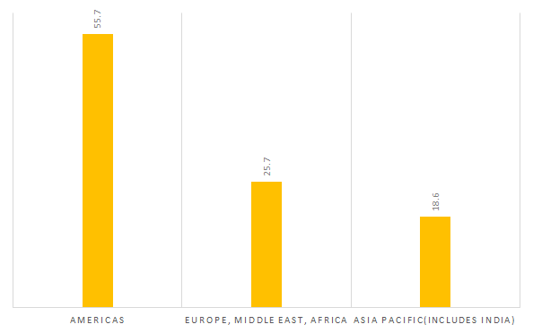
Cyient
In Q4 FY20, services revenue de-growth of 8.8% YoY (in CC), group revenue de-growth of 8.6% (in CC) and delivered normalized EBIT margins of 8.4%, lower by 118 bps QoQ .
Other income reduced to ₹206 Mn, down by 58.7%, mainly due to unrealized Fx losses and decrease in forward gains.
Design Led Manufacturing grew by 12.4% QoQ primarily due to standalone increase.
Balance sheet is remained somewhat strong with cash at US$130 Mn and debt at US$50 Mn.
A&D saw an increase by 4.7% QoQ (due to increased defense spending) but de-growth of 9.0% YoY mainly due to decline in commercial aerospace due to COVID-19.
Energy and utilities and semiconductors saw major decline of 20.5% and 22.3%.
The Company added 22 new customers.

Slide 35
Aerospace and defense (4.7% QoQ): Defense sector has seen a steady growth over the years and is expected to continue with optimistic estimate of 3-4% growth in defense spending as inter government tensions grow. As most of the revenue is from the exports to the Americas and USA being the major defense spender, revenue from defense is likely to rise in the coming future. Commercial aerospace has seen a descent in 2019 due to order backlog, and late deliverables. Boeing and Airbus estimates of more than 50% drop volume in the coming quarters due to COVID-19. This will effect IT companies but hopefully not to the extent of 50%. Its estimated by industry experts that it might take upto 18-24 months for the industry to get back on its feet but it will as going forward air travel is going to be popular.COVID-19 has only accelerated the depression part of this sector’s business cycle.This sector is expected to have a medium-term impact on the IT sector but is expected to return to normal in long-term.
Energy and Utilities(-20.5% QoQ): Major problems in this sector comes from the restrictions in field work in the facilities in the Americas. This too will have a medium impact but as businesses start to reopen this sector is expected to show good strength due to expected increased popularity of online maintenance of the services by the people.
Communications(-2% QoQ): Comms industry is expected to rise due to the introduction of 5G and increased demand of high speed internet. This will result in increased no. of clients n network management and designing sector.
Semiconductors(-22.3% QoQ): The decline witnessed in this industry is mainly due to supply chain restrictions such as raw materials from China etc. which should fade with the end of the pandemic. As automation will rise due to the social distancing norms, more and more devices will need chips and this will result in a great opportunity for IT companies to invest in new technologies and innovations.
Medical Technology and Healthcare(-10.9% QoQ): Increase in COVID related activities have had major in investment but non-COVID activities like elective surgeries are at a near zero level. This pandemic will instill major investment in the future in MT&H industry with better automation and management systems are demanded by the facilities.

Slide 36
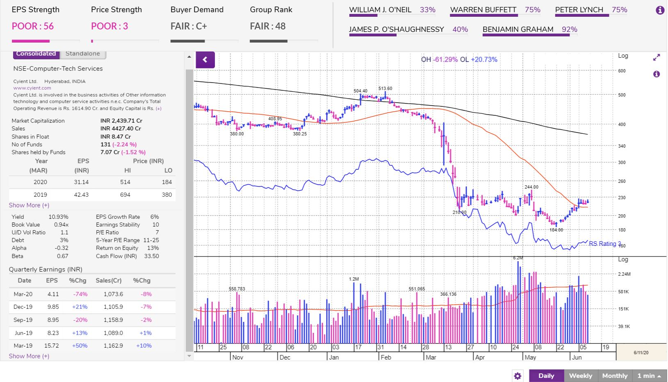
Poor price strength is considered mainly due to volume decline rather than price.
Institutional selling is the major reason for poor performance of the company
Fundamentals are expected to decline even further in the next two quarters before rising to normal

Slide 37
Conclusion
IT sector looked resistant even during a crisis
A decline, or at least a slowdown in growth expected in Q1 FY21
Margins remained good for the sector as a whole
Cost cut measures have been taken in most firms to maintain margins
More focus of firms on automation, digitization and cloud computing
Most firms signed large deals in the last two quarters which show the growth potential in the upcoming years
Market trend has been like a wave which dragged along with it some IT stocks, but has recovered quite a lot since May
Market might be in a bull trap, but investors like Jhunjhunwala remain optimistic for a full blown bull market

